Slide 1
Career Ladder Assessment
18th March 2020
Speaker: Prabhaker Reddy Vanam

Slide 2

AGENDA
PERSONAL PROFILE
WORK EXPERIANCE
ROLES & RESPONSIBILITIES
PROJECTS & CONTRIBUTIONS
PERSONAL DEVELOPMENT PLAN

Slide 3

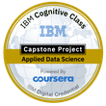
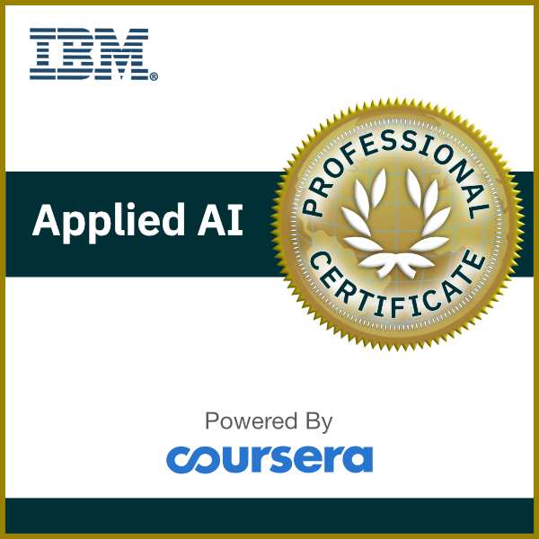
Profile Summary
About me:
Title: Senior Analyst IT Solutions
Experience: 15 Years (~9 years in ADNOC Onshore)
Interests: Music, Farming and Teaching
Education
Certifications
Specializations
Soft Skills
Masters in Computer Science, From Osmania UNI, India (2004)
Enterprise Content Management
Content Management Server Programming
IBM Applied Data Science (2019)
IBM Applied AI (2020)
Enterprise Content Management (Documentum suite, Captiva Capture, SharePoint)
Communication Skills
Problem Solving Skills
Collaboration Skills
Oracle Aconex – Project Collaboration
Bachelor of Science, From Osmania UNI, India (2001)

Slide 4



Work Experience
Senior Analyst, IT Applications
Joined ANOC ONSHORE
As Systems Analyst
Verinon Technology Solutions, India (Software Eng./Consultant)
201
2017
2011
2009
2005
eSolutions - MDS, Abu Dhabi (Documentum Consultant)
Notes:
Verinon Technology Solutions, India
(Software Eng./Consultant)
Java, Web Development, Content Management, eRoom
International Experience - Singapore, Malaysia, Thailand, Turkey, USA, Saudi, Bahrain
eSolutions - MDS,
Abu Dhabi
(Documentum Consultant)
Damanhealth
FAB(FGB)
Dubai Metro
ADNOC Onshore
Current - ADNOC Onshore
(Senior Analyst, IT Solutions)
eWellFile, Engineering EDMS, eTransmittal, Maximo EDMS, eTDF etc.
Digitization solutions

Slide 5



Roles & responsibilities
1
2
3
4
5
BUSINESS ANALYSIS
SOLUTION DESIGN
DEVELOPMENT
BUSINESS
CONTINUITY
PEOPLE
DEVELOPMENT
PROJECT
MANAGEMENT
Notes:
My roles and responsibilities are mainly around these
Business Analysis – Talking to the business units to understand the business needs and future plans. Providing proper solutions.
Ensure Standards Adherence
Close Interaction with various IT Department

Slide 6
PROJECTS & CONTRIBUTIONS
Engineering EDMS, eTransmittal
eWellFile / Technical Library
Scanning Solutions
Finance EDMS, Maximo Integration (ONERP)
Aconex Implementation
Business Value
Enabled Field Operations to quickly access right version of As-Built Drawings (P&ID, PLOT PLANS etc.)
Role
Solution Design and Development
Challenges and Risks
Migration of 3TB from Documentum v5.3 to v6.5
Achievements
Common repository for EDMS and eTransmittal
GIS-EDMS Integration (Geo Technical Report, SSSP)
Reduce variations and project delays, better review quality
Approved deliverable are automatically available in EDMS
Common Brava! viewer for both the EDMS and eTransmittal
80 Projects are live and using the system (60-EPC, 20-MASTER)
125,000+ documents are reviewed using eTransmittal system

Slide 7
PROJECTS & CONTRIBUTIONS
Engineering EDMS, eTransmittal
eWellFile / Technical Library
Finance EDMS, Maximo Integration
Scanning Solutions
Aconex Implementation
Business Value
Centralized Well File Repository and easily accessible to Drilling team, Asset teams, ADNOC and Shareholders
Role
Solution Design and Development
Challenges and Risks
Digitize hardcopy of the WellFile document from different locations
Achievements
Digitized 5 million pages with the help of UAE Nationals
Auto Classifying the documents
Training national team to do the digitization
Integrations with GIS, DWS & eWDP, EXPRIS (PROSOURCE)
Centralized WellFile documents and Technical library for easy access by different stakeholders

Slide 8
PROJECTS & CONTRIBUTIONS
Engineering EDMS, eTransmittal
eWellFile / Technical Library
Scanning Solutions
Finance EDMS, Maximo Integration (ONERP)
Aconex Implementation
Business Value
Documents are OCR enabled, PDF files are full text searchable
Role
Implementation/Development
Challenges and Risks
Ad-hack scanning requirement from different department (Procurement/Finance/Engineering/WellFile & Technical Library/Technical Center/ITD)
Achievements
Clear Office Space by Digitizing FCD Archival, Contracts, WellFiles and Tender documents
Clear Office Space
Training National/digitization Team
Supervising the digitization team
Improved HSE environment
Reducing operational cost
~6 million pages digitized by the team

Slide 9
PROJECTS & CONTRIBUTIONS
Engineering EDMS, eTransmittal
eWellFile / Technical Library
Scanning Solutions
Finance EDMS, Maximo Integration (ONERP)
Aconex Implementation
Business Value
Faster and more accurate invoice processing
Role
Solution Design and Development
Challenges and Risks
Digitize hardcopy 1300 Awarded Contracts document
Achievements
Invoice Auto registration in the Maximo
Maintenance Procedures controlled with version control
Automatic de-duplication of documents
Controlled access to awarded contracts
Integration with Maximo database
Digitized 1300 awarded contracts the with help of National team
Simplified Invoice/contracts indexing by Maximo integration
ONERP – Satellite Applications integration
ONERP – DMS data migration

Slide 10
PROJECTS & CONTRIBUTIONS
Engineering EDMS, eTransmittal
eWellFile / Technical Library
Scanning Solutions
Finance EDMS, Maximo Integration (ONERP)
Aconex Implementation
Business Value
Business Process Automation
Role
Implementation/Development
Challenges and Risks
Data on cloud ( not in our EDMS)
Achievements
MASTER Project Live
Project collaboration solution
Digitally connects all stakeholders
Real-time visibility
Integrations with EDMS application
Dashboard and Reports
Standard solution to all client – no client specific enhancements possible
In-House Implementation In Progress
Saved cost 450K AED for 2020
EPC – In Progress
Focal point from ADNOC Onshore

Slide 11
UAE NATIONALs DEVELOPMENT
Training young Nationals Documentum Technology
Support and train team in troubleshooting issues.
Training on new solutions (ADNOC HQ projects, Aconex, Operating Manuals etc.)
Career guidance and enhancement (IT Academy, Technical Courses, Data science, Share Best practices. etc.)
Notes:
In addition to my involvement with the scanning team I was assigned as coach for Reem
Training results - (DR EDMS, Scanning Workflows)
Real time involvement - (Supporting EDMS Applications, Administration)

Slide 12
Added value
Aligned to Adnoc KPI
Improve on site Safety with timely availability of As-built Data for smooth operation of facilities (Maintenance, Operations, control rooms etc.). SDS Portal for Chemical Safety Data Sheets
HSE & AI
Delivering of add-hoc requests (eWellFile & Tech Library, Notifications to DM & IO&E)
Profitability
Overall, Contribute to CAPEX/ OPEX reduction
Efficiency
Secured access control based implementation of system
Easier, quicker handovers to operating teams: no gap after start up
Performance
Helps young UAE Nationals with organizational learning
Helps engineers to manage associated information more efficiently
People
Closing Audit findings & Security Assessments
Enhancing the User Experience
Safeguarding company Assets and Data (EDMS DR System)

Slide 13


achievements
(2018 – till date)
2018
2019
2020
Certification in Data Science – Certified Applied AI Professional (from IBM)
Aconex Implementation @ ADNOC Onshore
For 2020 saved AED 450K – project Cost (23K per Project for ~20 projects). It will be around 2.3m AED from 2022 every year.
eTDF rollout
Master deliverables review thru eTransmittal
Optimized reporting on Convert to MASTER Tool
BRD for Technical Standards Feedback Management
POC for Tracking tool for eTransmittal deliverables
Certification in Data Science – Certified Applied Data science Professional (from IBM)
Supported DM/TC(IO&E)/Drilling to achieve their KPIs
Operating Manuals - SharePoint solutions for TC(IO&E)

Slide 14
Personal development Plan
Certifications in Data Science.
Focusing on Machine learning, Data Extraction (OCR)
Fully working with AI Solutions.
2020
2022
2019
2021
2023
Online Trainings (Data Science, SharePoint Administration)
Python Programming.
NLP, Deep learning & Computer Vision.
Data Scientist.

Slide 15
Certifications

Slide 16
Applied Data Science (IBM)

Slide 17
Applied AI (IBM)

Slide 18
Appreciation emails

Slide 19
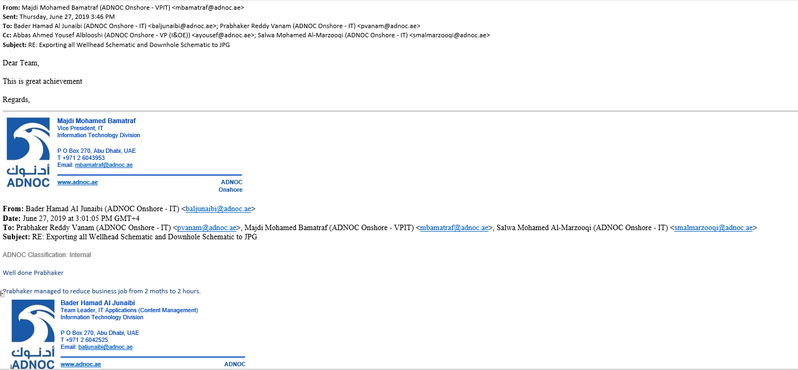
TC(IO&E)

Slide 20
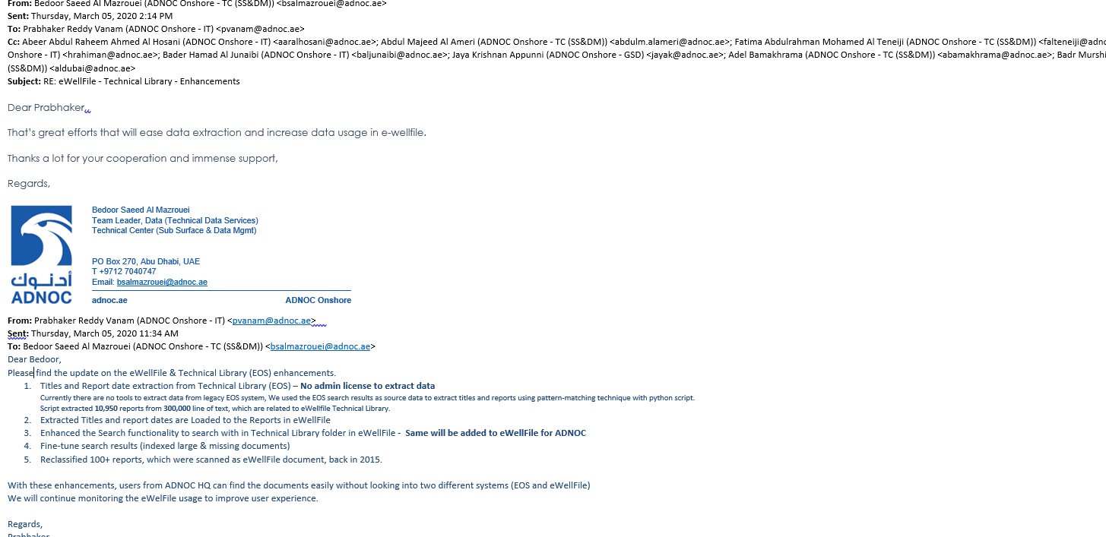
DATA MANAGEMENT

Slide 21
Thank you

